Slide 1
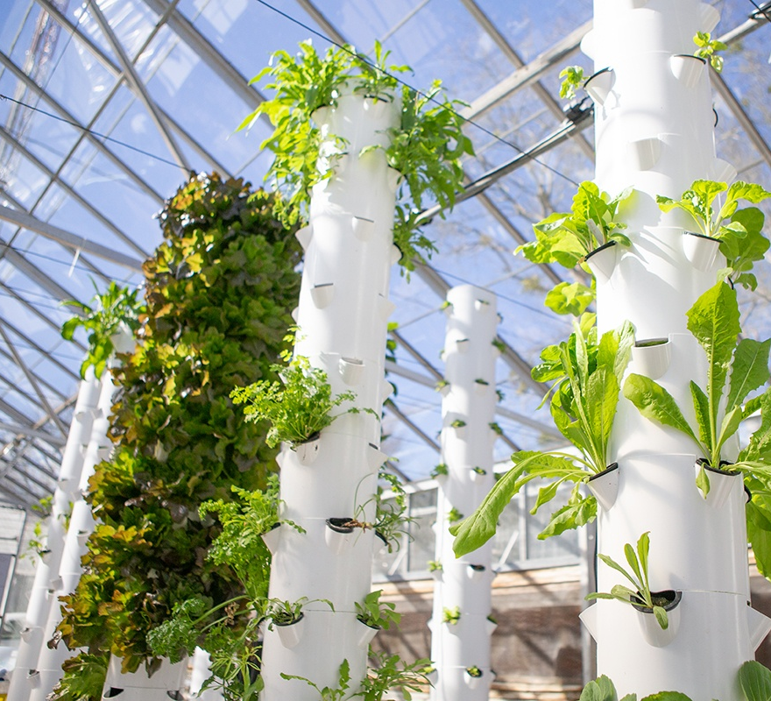
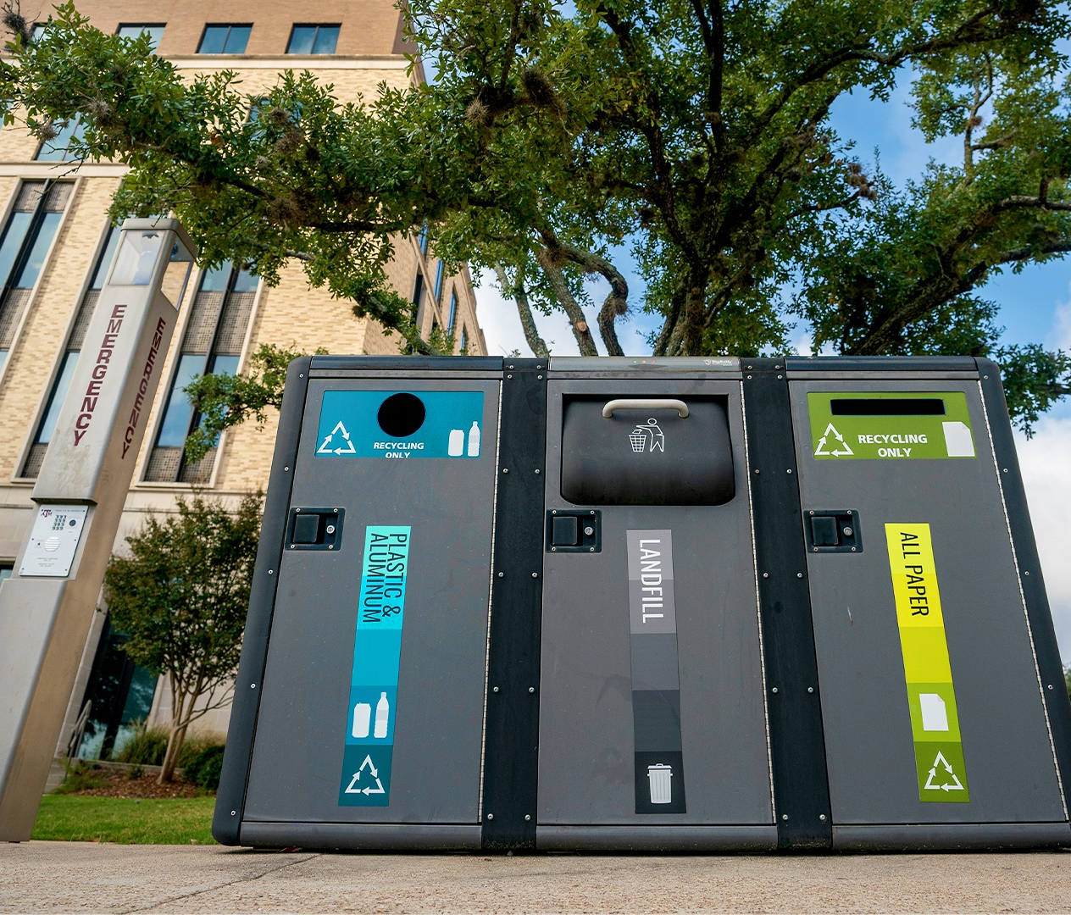

Introduction to Aggie Green Fund
Presented by Udit Singh Guleria
Notes:
Good morning everyone! I am excited to welcome you to my presentation today, where we’ll explore the Aggie Green Fund and how it empowers sustainability at Texas A&M University.

Slide 2
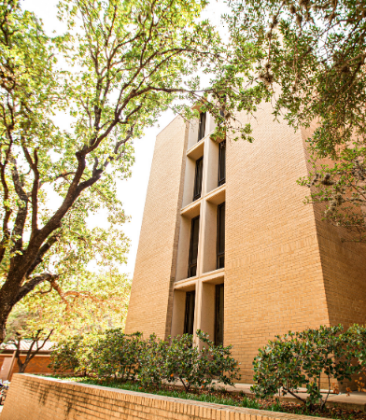
Agenda
Overview
Grant Requirements
Grant eligibility and application process
Selection Criteria
Notes:
Greetings! Today, I'll walk you through the Aggie Green Fund, its grant opportunities, the application process, grant requirements, and our selection criteria.

Slide 3
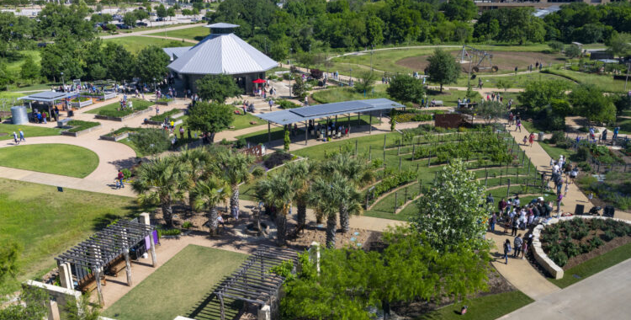
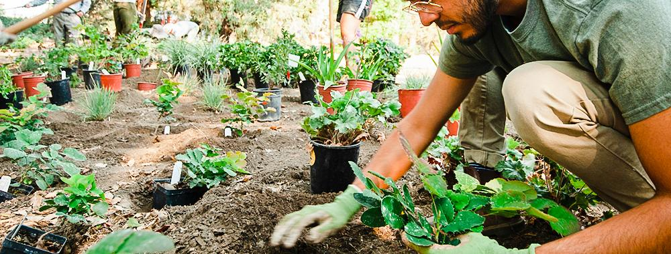
What is the Aggie Green Fund?
Student-led grant-giving organization for sustainability projects at TAMU
Founded in 2011
Provides Grants – Major & Micro
Awarded approx. $2.6 million to over 100 projects
Funded through Student Tuition & Fees
Notes:
The Aggie Green Fund, initiated in 2011, supports sustainability projects through grants.
Students, student organizations, faculty, and staff can apply for different types of grants to enhance campus sustainability.
This has led to visible improvements like water bottle filling stations and recycling bins around campus.
Till date the AGF has awarded $2.6 million, the fund has supported 100 projects, all benefiting students, faculty, and organizations.
Importantly, the Aggie Green Fund is financed by student tuition and fees, making it an opportunity for everyone to contribute to a more sustainable campus.

Slide 4
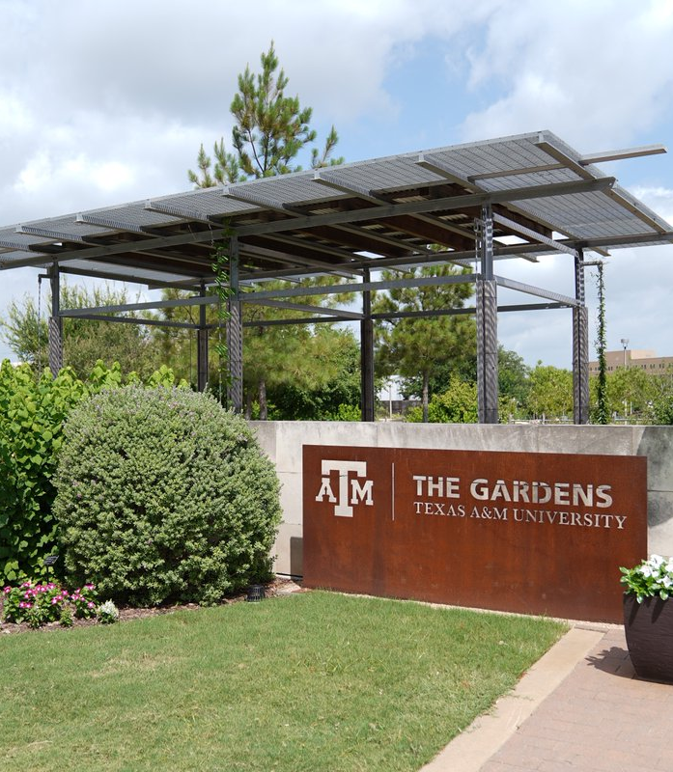
Grant Requirements
Projects should directly address environmental improvements on the Texas A&M College Station campus
Off Campus projects are ineligible
May not primarily address research aims
Have received written confirmation of support by campus officials
Include education/outreach/publicity
Regularly report on progress to the Aggie Green Fund Advisory Committee through WizeHive
More details: https://greenfund.tamu.edu/getagrant.html
Notes:
Grant Requirements Overview:
Focus on Campus Improvements: Your project should directly address environmental improvements on the Texas A&M University campus in College Station. Projects elsewhere are ineligible.
Research Component Consideration: While we primarily aim to fund sustainable projects that can make a tangible difference on campus, having a research component in your project won't disqualify you. We're just emphasizing that research aims aren't our primary focus.
Confirmation of Support: It's vital to have written confirmation of support from campus officials to ensure everyone is aligned and aware of the project details.
Incorporate Education, Outreach, and Publicity: We encourage you to include components of education, outreach, and publicity in your grant applications. This means demonstrating how your project can contribute to education, outreach efforts, and raising awareness about sustainability on campus.
Progress Reporting: We expect grantees to consistently report their project's progress so that we can stay updated. We have a dedicated portal called "Wize Hive" for this purpose. For further information, you can visit our website at [Green Fund Website URL]. We are here to support your sustainable initiatives and make the Texas A&M campus greener together.

Slide 5
Major Grants
Process
Eligibility
Two phase application process with grantee announcement on March 1st, 2024
Phase 1: Abstract
(Oct-Dec)
Submit a general idea of your project budget, and timeline between October 2 and November 3
Selected applicatnts are announced in December and invited to Phase 2
Phase 2: Full Aplication
(Dec-Feb)
Submit detailed information about your project and be prepared to begin implementation
In addition to meeting the eligibility criteria for all AGF projects, the following conditions apply:
Projects must commence active implementation by September 15, 2024, and reach completion by August 31, 2025.
For projects requiring approval from CBE (possibly an internal or external body), they must commence active implementation within 3 months and attain project completion within 18 months of receiving CBE approval.
Notes:
If a proposed project costs more than $3,500 and/or will not be completed within six months of fund disbursement, applicants are encouraged to submit a Major Grant application to the Aggie Green Fund Advisory Committee (AGFAC). Major grants are more involved than micro-grants and follow a two-phase application process. Grantee announcements occur on March 1.
Phase 1: Abstract (October 4 - November 4)
In this phase, applicants submit a project overview, including their goals, budget, and timeline.
Selected applicants are revealed on December 1 and invited to proceed to Phase 2.
Phase 2: Full Application
This phase delves deeper into project details, including approvals from relevant parties.
The goal is to demonstrate readiness for implementation once funding is secured.
Eligibility Criteria for Major Grants:
Projects must commence active implementation by September 15, 2024, and conclude by August 31, 2025.
Projects needing approval from CBE (Campus Building Enhancement) follow a different timeline: starting within three months after CBE approval and completing within 18 months.
These timelines ensure projects stay on track while allowing flexibility for CBE approval processes.

Slide 6
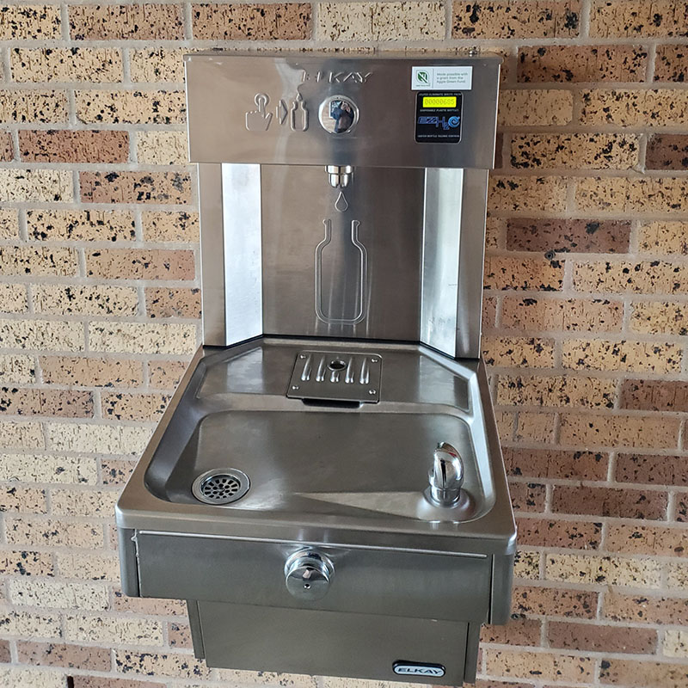
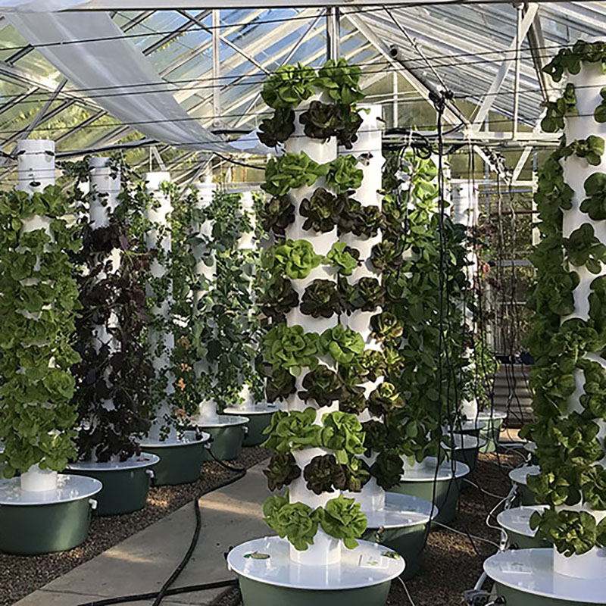
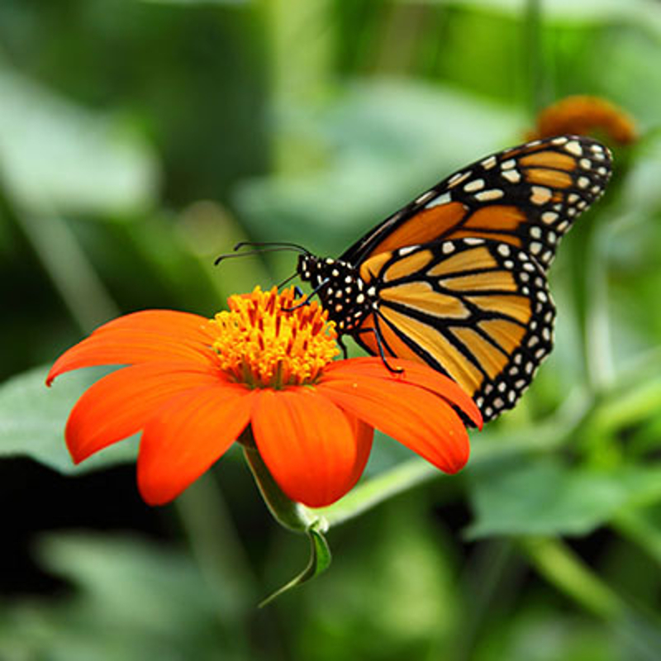
Major Grant Projects
Outdoor Hydration Stations (2020)
TAMU Urban Farm United (2019)
Aggieland Monarch Project(2015)
Notes:
Outdoor Hydration Stations (2020)
This project, by Residence Life, will promote sustainable practices, reduce plastic bottles in the landfill, save money from the purchase of bottled water, and make it convenient to consume recommended amounts of water every day.
TAMU Urban Farm United (2019)
TAMU Urban Farm United (TUFU) is a local micro-farm project utilizing a vertical aeroponic food growing system to distribute fresh food to the 12th Can, Texas A&M’s food pantry. The project will raise awareness around the problems of food insecurity and human and environmental health.
Aggieland Monarch Project (2015)
The project aims to restore Monarch populations by establishing habitat for the butterflies on their annual migration through the Brazos Valley.

Slide 7
Micro Grants
Process
Eligibility
We begin accepting applications on a rolling basis starting September 15th.
Applications continue to be accepted until either the funds are depleted or until March 1, whichever comes first.
Funding decisions are made within a span of 30-45 days.
In addition to the eligibility criteria for all AGF projects:
The project budget should not exceed $3,500.
The project must be completed within a timeframe of 6 months.
The project should not necessitate approval from CBE (Campus Building Enhancement).
Notes:
Micro Grants are designed for smaller-scale projects with shorter timeframes and lower funding needs.
Applications for microgrants are accepted on a rolling basis starting from September 15. Applying early increases your chances of securing funding.
The application window remains open until funds are exhausted or until March 1, whichever comes first. Applying early is key due to limited funds.
Funding decisions are typically made within 30 to 45 days, as applications are reviewed on an ongoing basis.
General Eligibility for Micro Grants:
Projects must have a budget of $3,500 or less.
The project should be completed within six months, indicating a shorter implementation timeline.
Projects must not require Council for Built Environment (CBE) approval. This means that highly visible changes to campus, like constructing a garden or altering building facades, would necessitate a Major Grant application.
In summary, Micro Grants are suitable for projects with budgets of $3,500 or less, expected to be completed within six months, and not requiring CBE approval. Larger or more complex projects may consider applying for Major Grants instead.

Slide 8
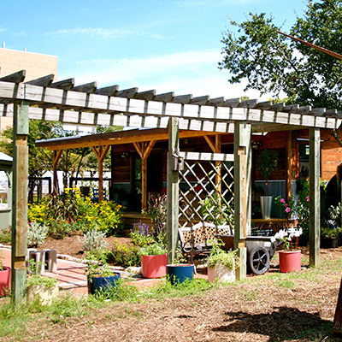
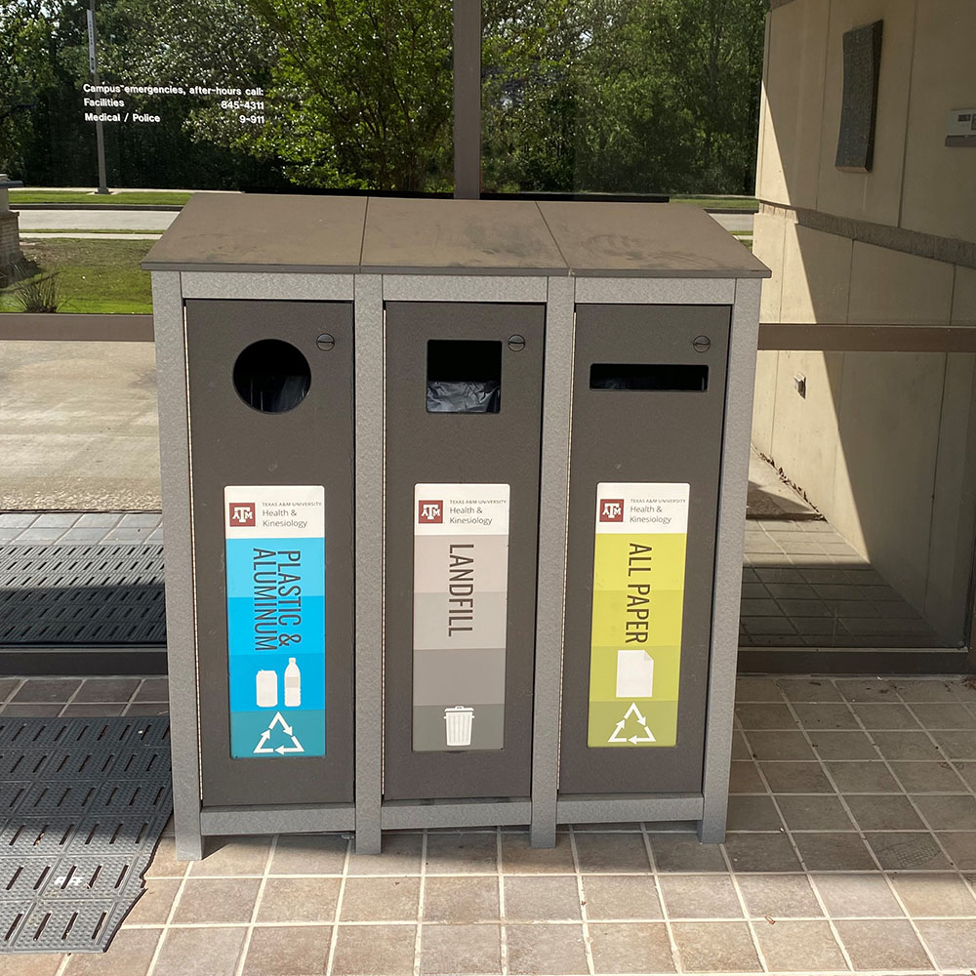
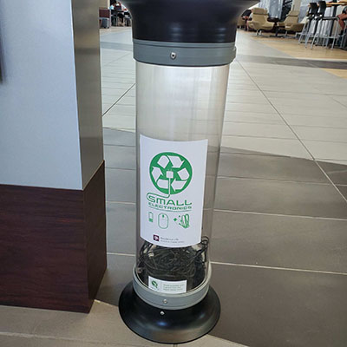
Micro-Grant Projects
All in one oil sensor (2021)
Providing Access to Recycling Bins in Health and Kinesiology (2020)
Gladson E-Waste Bins (2019)
Notes:
Oil Sensor
Developing a sensor to measure environmental factors (moisture, light, temperature) for sustainable farming at Howdy Farm. Providing Access to Recycling Bins in Health and Kinesiology
Installed recycling bins in the Health & Kinesiology Department's Gibb Gilchrist Building to reduce landfill waste, boost departmental recycling, and provide easy access to recycling for students and staff.
Gladson E-Waste Bins - $385
Residence Life added three e-waste recycling containers to address on-campus e-waste collection needs, reduce landfill waste, educate students about e-waste recycling, and minimize environmental concerns from electronics disposal.

Slide 9

Selection Criteria
The grant application review committee assesses grant applications in eleven key areas:
Concept
Clarity and quality of the application
Project team's capabilities
Evaluation and follow-up strategies
Environmental impact assessment
Campus impact assessment
Student Involvement
Outreach and publicity plans
Budget evaluation
Cost-effectiveness analysis
Academic gains
Preference is given to projects with strong student involvement and/or that demonstrate the greatest reduction in Texas A&M University’s environmental impact in a cost-effective manner
Notes:
Selection Criteria Overview:
We evaluate grant applications based on 11 specific areas. These criteria help us assess the potential impact and feasibility of your project.
1. Concept: We look for well-thought-out project concepts.
2. Well-Written Application: A well-structured application without grammatical errors is crucial.
3. Capability of Project Team: Confidence in your team's ability to execute the project is essential.
4. Evaluation and Follow-Up: Demonstrating a clear plan for project assessment and follow-up.
5. Environmental Impact: We value projects that positively affect the environment.
6. Campus Impact: Projects should make a noticeable difference on our campus.
7. Student Involvement: Involving students is highly encouraged.
8. Outreach and Publicity: Promoting your project and its green impact is essential.
9. Budget and Cost-Effectiveness: Projects should have a financially feasible plan.
10. Academic Gains: Consider how your project contributes to academic growth.
These criteria provide guidance, but projects don't need to meet every single one. However, projects with strong student involvement and those that significantly reduce our environmental impact in a cost-effective manner receive preference.
For more details on these criteria and additional information, please visit the Green Fund website. These criteria help us select projects that align with our goal of creating a sustainable and impactful campus community.

Slide 10

Important Dates
Major Grant
October 2, 2023 - Abstract Submission Opens
November 3, 2023, 5 p.m. CST - Abstract Submission Closes
December 4, 2023 - Abstract Approvals Announced
December 4, 2023 - Full Application Submission Opens
February 1, 2024, 5 p.m. CST - Full Application Submission Closes
March 1, 2024 - Major Grant Recipients Announced
Micro Grant
September 15, 2023 - Micro-Grants Open
March 1, 2024, 5 p.m. - Micro-Grants Close
Notes:
To help you stay on track, I have mentioned the import application dates. The given information is also available on our website

Slide 11

Contact Us!
sustainability@tamu.edu
greenfund-info@tamu.edu
greenfund-marketing@tamu.edu
Notes:
Feel free to reach out to us on the given email ids.

